Slide 1
Regression: Case Study

Slide 2

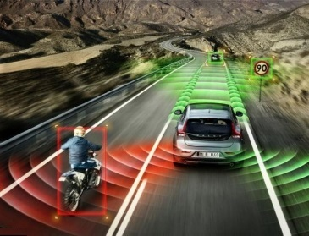


Regression
Stock Market Forecast
Self-driving Car
Recommendation
Dow Jones Industrial Average at tomorrow
$$f\left( \right)=$$
$$f\left( \right)=$$
方向盤角度
$$f\left( \right)=$$
購買可能性
使用者 A
商品 B

Slide 3
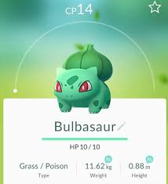







Example Application
Estimating the Combat Power (CP) of a pokemon after evolution
$$x_{cp}$$
CP after evolution
$$f\left( \right)=$$
$$y$$
$$x_{s}$$
$$x$$
$$x_{hp}$$
$$x_{w}$$
$$x_{h}$$

Slide 4

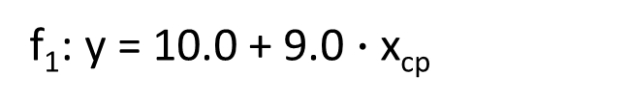
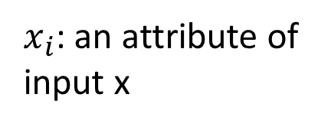
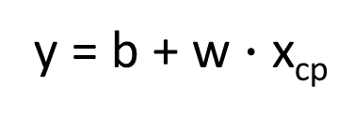
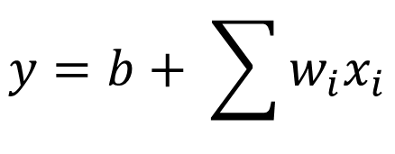

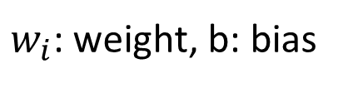
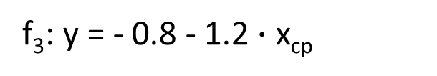
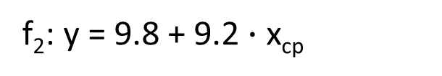

Step 1: Model
w and b are parameters (can be any value)
y = b + w $∙$ x_{cp}
f₁: y = 10.0 + 9.0 $∙$ x_{cp}
A set of function
Model
f₂: y = 9.8 + 9.2 $∙$ x_{cp}
f₃: y = - 0.8 - 1.2 $∙$ x_{cp}
…… infinite
CP after evolution
$$x$$
$$y$$
$$f\left( \right)=$$
$x_{i}$: an attribute of input x
$$y=b+ \sum{w_{i}x_{i}}$$
Linear model:
feature
$w_{i}$: weight, b: bias

Slide 5
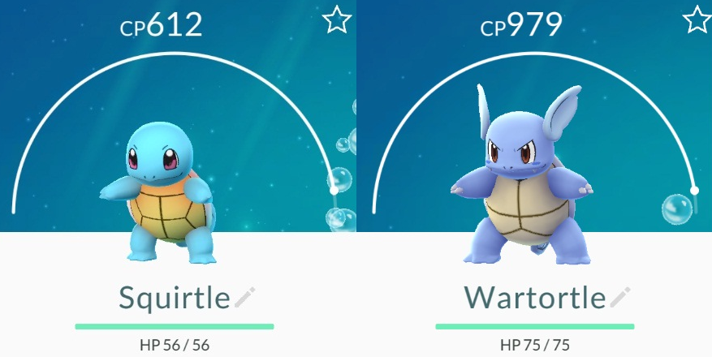
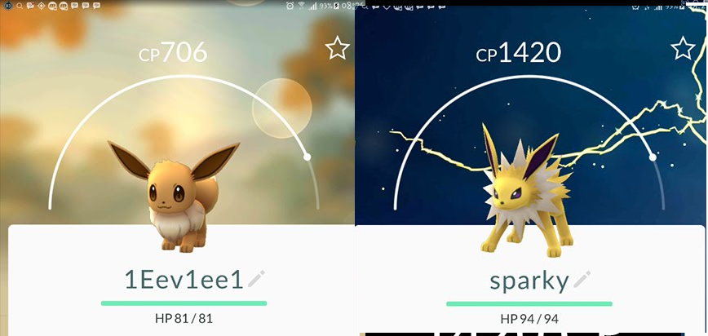




Step 2: Goodness of Function
y = b + w $∙$ x_{cp}
A set of function
Model
function
input:
function
Output (scalar):
$${\hat{y}}^{1}$$
$$x^{1}$$
$${\hat{y}}^{2}$$
$$x^{2}$$
Training
Data
Notes:
卡咪龜

Slide 6
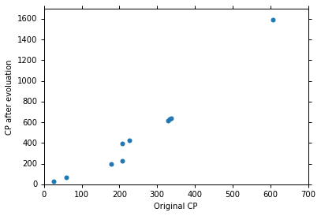







Step 2: Goodness of Function
Training Data: 10 pokemons
$$\left(x^{1},{\hat{y}}^{1}\right)$$
$$\left(x^{2},{\hat{y}}^{2}\right)$$
$$\left(x_{cp}^{n},{\hat{y}}^{n}\right)$$
$$……$$
$$\hat{y}$$
$$\left(x^{10},{\hat{y}}^{10}\right)$$
This is real data.
$$x_{cp}$$
Source: https://www.openintro.org/stat/data/?data=pokemon

Slide 7
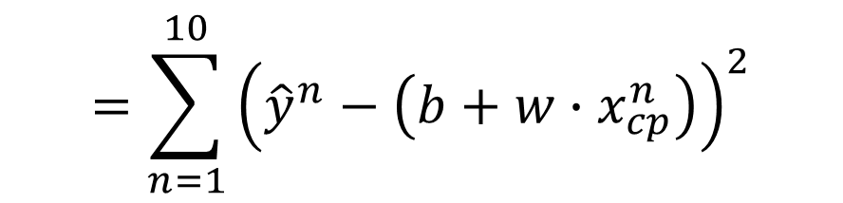

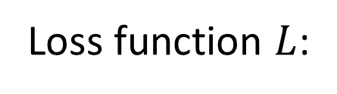
Step 2: Goodness of Function
y = b + w $∙$ x_{cp}
A set of function
Model
Loss function $L$:
Goodness of function f
Input: a function, output: how bad it is
$$L\left(f\right)=L\left(w,b\right)$$
Estimated y based on input function
$$=\sum_{n=1}^{10}{{\left({\hat{y}}^{n}−\left(b+w∙x_{cp}^{n}\right)\right)}^{2}}$$
Training
Data
Estimation error
Sum over examples

Slide 8
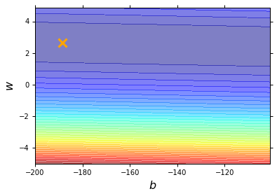
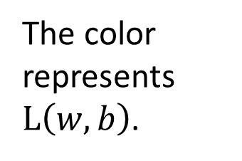
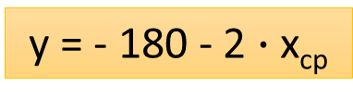
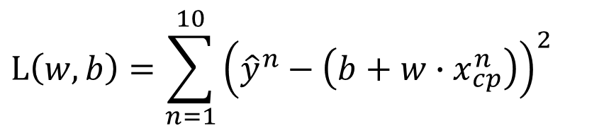
Step 2: Goodness of Function
$$L\left(w,b\right)=\sum_{n=1}^{10}{{\left({\hat{y}}^{n}−\left(b+w∙x_{cp}^{n}\right)\right)}^{2}}$$
Loss Function
Each point in the figure is a function
smallest
y = - 180 - 2 $∙$ x_{cp}
The color represents $L\left(w,b\right)$.
Very large
(true example)

Slide 9

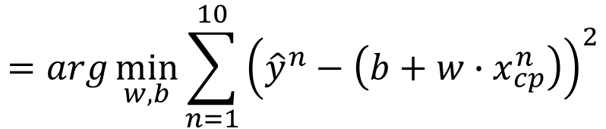

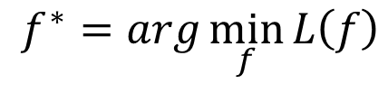
Step 3: Best Function
$$L\left(w,b\right)$$
$$=\sum_{n=1}^{10}{{\left({\hat{y}}^{n}−\left(b+w∙x_{cp}^{n}\right)\right)}^{2}}$$
A set of function
Model
Goodness of function f
Pick the “Best” Function
$$f^{∗}=\arg{\min_{f}{L\left(f\right)}}$$
Gradient Descent
Training
Data
$$w^{∗},b^{∗}=arg\min_{w,b}{L\left(w,b\right)}$$
$$=arg\min_{w,b}{\sum_{n=1}^{10}{{\left({\hat{y}}^{n}−\left(b+w∙x_{cp}^{n}\right)\right)}^{2}}}$$

Slide 10

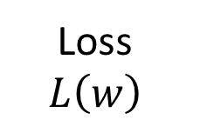
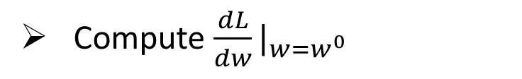

Step 3: Gradient Descent
http://chico386.pixnet.net/album/photo/171572850
$$w^{∗}=arg\min_{w}{L\left(w\right)}$$
Consider loss function 𝐿(𝑤) with one parameter w:
(Randomly) Pick an initial value w⁰
Compute $\frac{dL}{dw}|_{w=w^{0}}$
Loss
$$L\left(w\right)$$
Negative
Increase w
Positive
Decrease w
w⁰

Slide 11
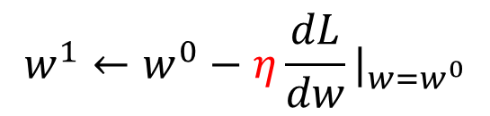

Step 3: Gradient Descent
http://chico386.pixnet.net/album/photo/171572850
$$w^{∗}=arg\min_{w}{L\left(w\right)}$$
Consider loss function 𝐿(𝑤) with one parameter w:
(Randomly) Pick an initial value w⁰
Compute $\frac{dL}{dw}|_{w=w^{0}}$
$$w^{1}←w^{0}−η\frac{dL}{dw}|_{w=w^{0}}$$
Loss
$$L\left(w\right)$$
η is called “learning rate”
w⁰
$$−η\frac{dL}{dw}|_{w=w^{0}}$$

Slide 12


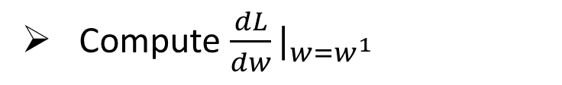
Step 3: Gradient Descent
$$w^{∗}=arg\min_{w}{L\left(w\right)}$$
Consider loss function 𝐿(𝑤) with one parameter w:
(Randomly) Pick an initial value w⁰
Compute $\frac{dL}{dw}|_{w=w^{0}}$
$$w^{1}←w^{0}−η\frac{dL}{dw}|_{w=w^{0}}$$
Loss
$$L\left(w\right)$$
Compute $\frac{dL}{dw}|_{w=w^{1}}$
$$w^{2}←w^{1}−η\frac{dL}{dw}|_{w=w^{1}}$$
…… Many iteration
Local optimal
not global optimal
w⁰
w¹
w²
w^{T}

Slide 13

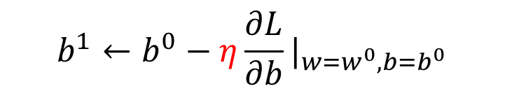

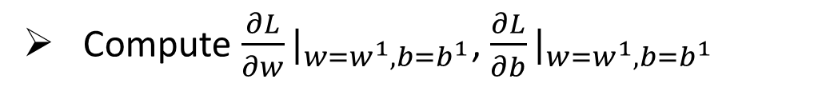
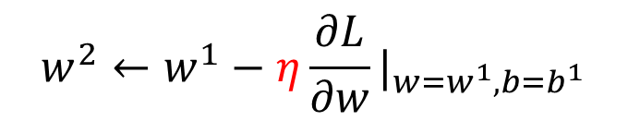



Step 3: Gradient Descent
$$\left[\begin{aligned}\frac{∂L}{∂w} \\ \frac{∂L}{∂b}\end{aligned}\right]$$
$$∇L=$$
gradient
How about two parameters?
$$w^{∗},b^{∗}=arg\min_{w,b}{L\left(w,b\right)}$$
(Randomly) Pick an initial value w⁰, b⁰
Compute $\frac{∂L}{∂w}|_{w=w^{0},b=b^{0}}$, $\frac{∂L}{∂b}|_{w=w^{0},b=b^{0}}$
$$w^{1}←w^{0}−η\frac{∂L}{∂w}|_{w=w^{0},b=b^{0}}$$
$$b^{1}←b^{0}−η\frac{∂L}{∂b}|_{w=w^{0},b=b^{0}}$$
Compute $\frac{∂L}{∂w}|_{w=w^{1},b=b^{1}}$, $\frac{∂L}{∂b}|_{w=w^{1},b=b^{1}}$
$$w^{2}←w^{1}−η\frac{∂L}{∂w}|_{w=w^{1},b=b^{1}}$$
$$b^{2}←b^{1}−η\frac{∂L}{∂b}|_{w=w^{1},b=b^{1}}$$
Notes:
鄭凱文

Slide 14
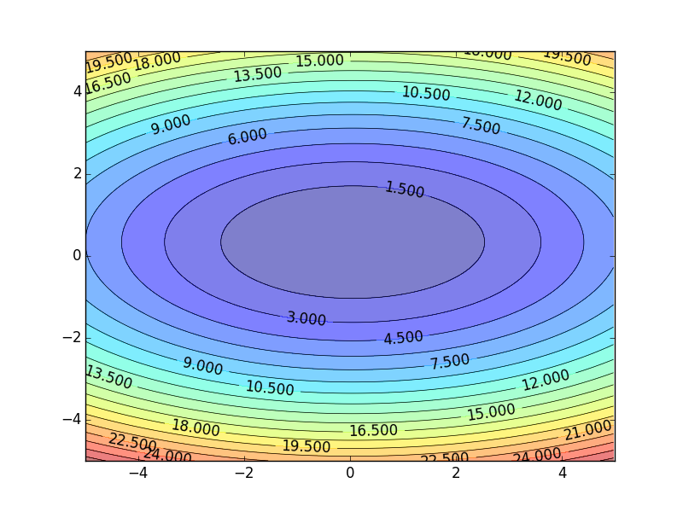
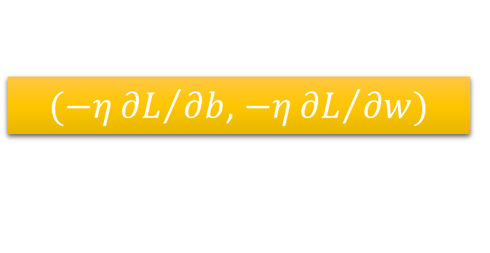
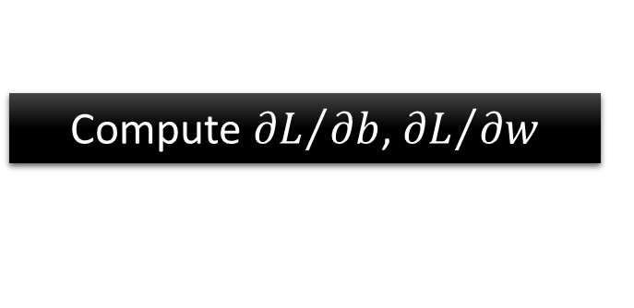


Step 3: Gradient Descent
Color: Value of Loss L(w,b)
$$w$$
$(−η{∂L}/{∂b}$, $−η{∂L}/{∂w})$
Compute ${∂L}/{∂b}$, ${∂L}/{∂w}$
$$b$$
Notes:
Questions: image you are playing AOC
A network can have millions of parameters.
Backpropagation is the way to compute the gradients efficiently (not today)
Ref: http://speech.ee.ntu.edu.tw/~tlkagk/courses/MLDS_2015_2/Lecture/DNN%20backprop.ecm.mp4/index.html

Slide 15
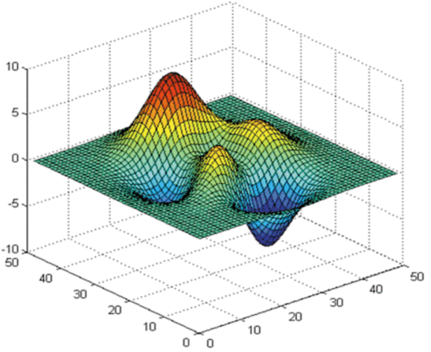





Step 3: Gradient Descent
Worry?
Don’t worry. In linear regression, the loss function L is convex.
No local optimal
$$L$$
$$w$$
$$w$$
$$b$$
$$b$$

Slide 16
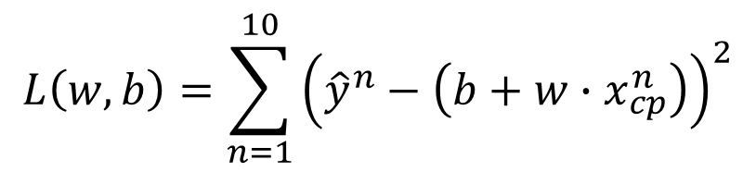

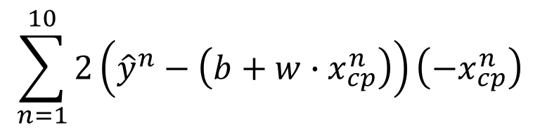


Step 3: Gradient Descent
Formulation of ${∂L}/{∂w}$ and ${∂L}/{∂b}$
$$L\left(w,b\right)=\sum_{n=1}^{10}{{\left({\hat{y}}^{n}−\left(b+w∙x_{cp}^{n}\right)\right)}^{2}}$$
$$\sum_{n=1}^{10}{2\left({\hat{y}}^{n}−\left(b+w∙x_{cp}^{n}\right)\right)\left(−x_{cp}^{n}\right)}$$
$$\frac{∂L}{∂w}=?$$
$$\frac{∂L}{∂b}=?$$

Slide 17
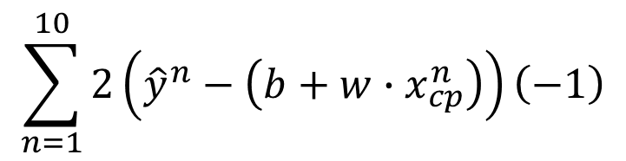
Step 3: Gradient Descent
Formulation of ${∂L}/{∂w}$ and ${∂L}/{∂b}$
$$L\left(w,b\right)=\sum_{n=1}^{10}{{\left({\hat{y}}^{n}−\left(b+w∙x_{cp}^{n}\right)\right)}^{2}}$$
$$\sum_{n=1}^{10}{2\left({\hat{y}}^{n}−\left(b+w∙x_{cp}^{n}\right)\right)\left(−x_{cp}^{n}\right)}$$
$$\frac{∂L}{∂w}=?$$
$$\frac{∂L}{∂b}=?$$
$$\sum_{n=1}^{10}{2\left({\hat{y}}^{n}−\left(b+w∙x_{cp}^{n}\right)\right)\left(−1\right)}$$

Slide 18
Step 3: Gradient Descent
Notes:
http://python.ntu.edu.tw/user/tlkagk/notebooks/Gradient%20Descent%20Demo.ipynb
Demo?????????????????????????????????????

Slide 19
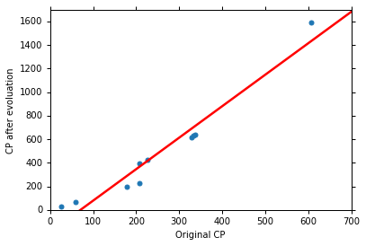
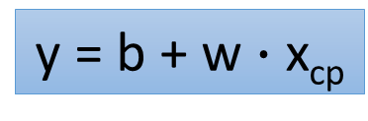
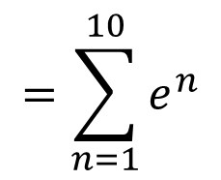


How’s the results?
Training Data
y = b + w $∙$ x_{cp}
b = -188.4
$$e^{1}$$
w = 2.7
Average Error on Training Data
$$e^{2}$$
$$=\sum_{n=1}^{10}{e^{n}}$$
= 31.9

Slide 20
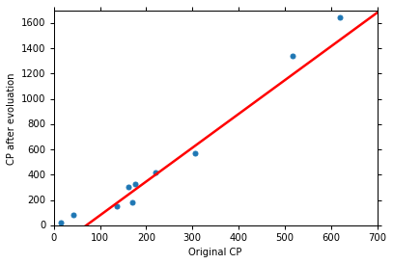
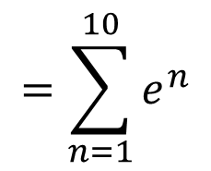
How’s the results? - Generalization
What we really care about is the error on new data (testing data)
Another 10 pokemons as testing data
y = b + w $∙$ x_{cp}
b = -188.4
How can we do better?
w = 2.7
Average Error on Testing Data
$$=\sum_{n=1}^{10}{e^{n}}$$
= 35.0
> Average Error on Training Data (31.9)

Slide 21
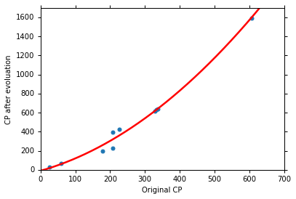

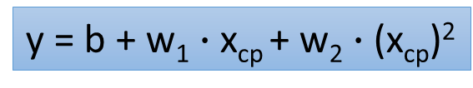
Selecting another Model
y = b + w₁ $∙$ x_{cp} + w₂ $∙$ (x_{cp})²
Best Function
b = -10.3
w₁ = 1.0, w₂ = 2.7 x 10⁻³
Average Error = 15.4
Testing:
Average Error = 18.4
Better! Could it be even better?

Slide 22
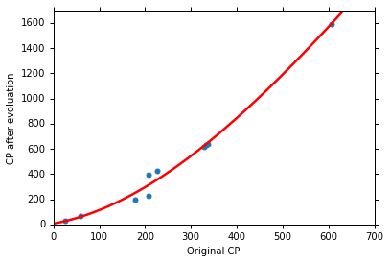
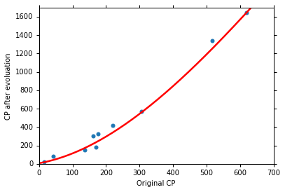
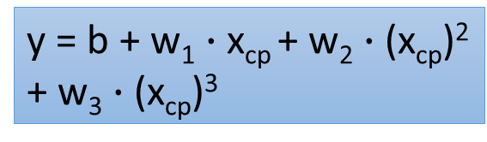
Selecting another Model
y = b + w₁ $∙$ x_{cp} + w₂ $∙$ (x_{cp})²
+ w₃ $∙$ (x_{cp})³
Best Function
b = 6.4, w₁ = 0.66
w₂ = 4.3 x 10⁻³
w₃ = -1.8 x 10⁻⁶
Average Error = 15.3
Testing:
Average Error = 18.1
Slightly better.
How about more complex model?

Slide 23



Selecting another Model
y = b + w₁ $∙$ x_{cp} + w₂ $∙$ (x_{cp})²
+ w₃ $∙$ (x_{cp})³ + w₄ $∙$ (x_{cp})⁴
Best Function
Average Error = 14.9
Testing:
Average Error = 28.8
The results become worse ...

Slide 24



Selecting another Model
y = b + w₁ $∙$ x_{cp} + w₂ $∙$ (x_{cp})²
+ w₃ $∙$ (x_{cp})³ + w₄ $∙$ (x_{cp})⁴
+ w₅ $∙$ (x_{cp})⁵
Best Function
Average Error = 12.8
Testing:
Average Error = 232.1
The results are so bad.

Slide 25






Model Selection
Training Data
1.
y = b + w $∙$ x_{cp}
2.
y = b + w₁ $∙$ x_{cp} + w₂ $∙$ (x_{cp})²
y = b + w₁ $∙$ x_{cp} + w₂ $∙$ (x_{cp})²
+ w₃ $∙$ (x_{cp})³
3.
y = b + w₁ $∙$ x_{cp} + w₂ $∙$ (x_{cp})²
+ w₃ $∙$ (x_{cp})³ + w₄ $∙$ (x_{cp})⁴
4.
y = b + w₁ $∙$ x_{cp} + w₂ $∙$ (x_{cp})²
+ w₃ $∙$ (x_{cp})³ + w₄ $∙$ (x_{cp})⁴
+ w₅ $∙$ (x_{cp})⁵
A more complex model yields lower error on training data.
5.
If we can truly find the best function

Slide 26

Model Selection
 | Training | Testing
1 | 31.9 | 35.0
2 | 15.4 | 18.4
3 | 15.3 | 18.1
4 | 14.9 | 28.2
5 | 12.8 | 232.1
Overfitting
A more complex model does not always lead to better performance on testing data.
This is Overfitting.
Select suitable model
Notes:
metaphohr

Slide 27

Let’s collect more data
There is some hidden factors not considered in the previous model ……

Slide 28





What are the hidden factors?
Eevee
Pidgey
Weedle
Caterpie
Notes:
Species
獨角蟲-
綠毛蟲

Slide 29










Back to step 1: Redesign the Model
$$y=b+ \sum{w_{i}x_{i}}$$
Linear model?
x
$x_{s}=\text{species}$ of x
If $x_{s}=\text{Pidgey}$:
$$y=b_{1}+w_{1}∙x_{cp}$$
If $x_{s}=\text{Weedle}$:
$$y=b_{2}+w_{2}∙x_{cp}$$
If $x_{s}=\text{Caterpie}$:
$$y=b_{3}+w_{3}∙x_{cp}$$
If $x_{s}=\text{Eevee}$:
$$y=b_{4}+w_{4}∙x_{cp}$$
y
Notes:
Pidgey
Weedle
Caterpie
Eevee

Slide 30












Back to step 1: Redesign the Model
$$y=b+ \sum{w_{i}x_{i}}$$
Linear model?
$$y=b_{1}∙δ\left(x_{s}=\text{Pidgey}\right)$$
1
1
$$+w_{1}∙δ\left(x_{s}=\text{Pidgey}\right)x_{cp}$$
$$δ\left(x_{s}=\text{Pidgey}\right)$$
0
$$+b_{2}∙δ\left(x_{s}=\text{Weedle}\right)$$
=1
If $x_{s}=\text{Pidgey}$
$$+w_{2}∙δ\left(x_{s}=\text{Weedle}\right)x_{cp}$$
0
=0
otherwise
$$+b_{3}∙δ\left(x_{s}=\text{Caterpie}\right)$$
0
$$+w_{3}∙δ\left(x_{s}=\text{Caterpie}\right)x_{cp}$$
0
If $x_{s}=\text{Pidgey}$
$$+b_{4}∙δ\left(x_{s}=\text{Eevee}\right)$$
0
$$y=b_{1}+w_{1}∙x_{cp}$$
$$+w_{4}∙δ\left(x_{s}=\text{Eevee}\right)x_{cp}$$
0
Notes:
Pidgey
Weedle
Caterpie
Eevee

Slide 31


Training Data
Average error = 3.8
Testing
Data
Average error = 14.3

Slide 32



Are there any other hidden factors?
CP after evolution
weight
CP after evolution
CP after evolution
Height
HP

Slide 33









Back to step 1: Redesign the Model Again
x
If $x_{s}=\text{Pidgey}$:
$$y′=b_{1}+w_{1}∙x_{cp}+w_{5}∙{\left(x_{cp}\right)}^{2}$$
If $x_{s}=\text{Weedle}$:
$$y′=b_{2}+w_{2}∙x_{cp}+w_{6}∙{\left(x_{cp}\right)}^{2}$$
Training Error
= 1.9
If $x_{s}=\text{Caterpie}$:
$$y′=b_{3}+w_{4}∙x_{cp}+w_{7}∙{\left(x_{cp}\right)}^{2}$$
$$y′=b_{4}+w_{4}∙x_{cp}+w_{8}∙{\left(x_{cp}\right)}^{2}$$
Testing Error
= 102.3
If $x_{s}=\text{Eevee}$:
$$y=y′+w_{9}∙x_{hp}+w_{10}∙{\left(x_{hp}\right)}^{2}$$
Overfitting!
$$+w_{11}∙x_{h}+w_{12}∙{\left(x_{h}\right)}^{2}+w_{13}∙x_{w}+w_{14}∙{\left(x_{w}\right)}^{2}$$
y
Notes:
Put all the information

Slide 34







Back to step 2: Regularization
$$y=b+ \sum{w_{i}x_{i}}$$
The functions with smaller $w_{i}$ are better
$$L=\sum_{n}{{\left({\hat{y}}^{n}−\left(b+ \sum{w_{i}x_{i}}\right)\right)}^{2}}$$
$$+λ\sum{{\left(w_{i}\right)}^{2}}$$
Why smooth functions are preferred?
$$y=b+ \sum{w_{i}x_{i}}$$
$$+w_{i}Δx_{i}$$
$$+Δx_{i}$$
If some noises corrupt input x_{i} when testing
A smoother function has less influence.

Slide 35



Regularization
$$λ$$ | Training | Testing
0 | 1.9 | 102.3
1 | 2.3 | 68.7
10 | 3.5 | 25.7
100 | 4.1 | 11.1
1000 | 5.6 | 12.8
10000 | 6.3 | 18.7
100000 | 8.5 | 26.8
smoother
How smooth?
Select $λ$ obtaining the best model
Training error: larger$λ$, considering the training error less
We prefer smooth function, but don’t be too smooth.

Slide 36
Conclusion & Following Lectures
Pokemon: Original CP and species almost decide the CP after evolution (there are probably other hidden factors)
Gradient descent
Following lectures: theory and tips
Overfitting and Regularization
Following lectures: more theory behind these
We finally get average error = 11.1 on the testing data
How about another set of new data? Underestimate? Overestimate?
Following lectures: validation

Slide 37
Acknowledgment
感謝 鄭凱文 同學發現投影片上的符號錯誤

